Slide 1
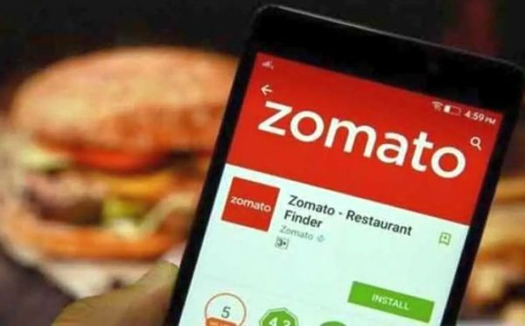

Zomato Restaurants EDA
Presenter:
Pavan Kalyan

Slide 2

Agenda
Introduction & Objective
Data Collection & Understanding
Data Cleaning & Preprocessing
Exploratory Data Analysis
Statistical Analysis
Business Insights
Machine Learning Model
Conclusion & Recommendations
Future Scope
Restaurant Analysis

Slide 3
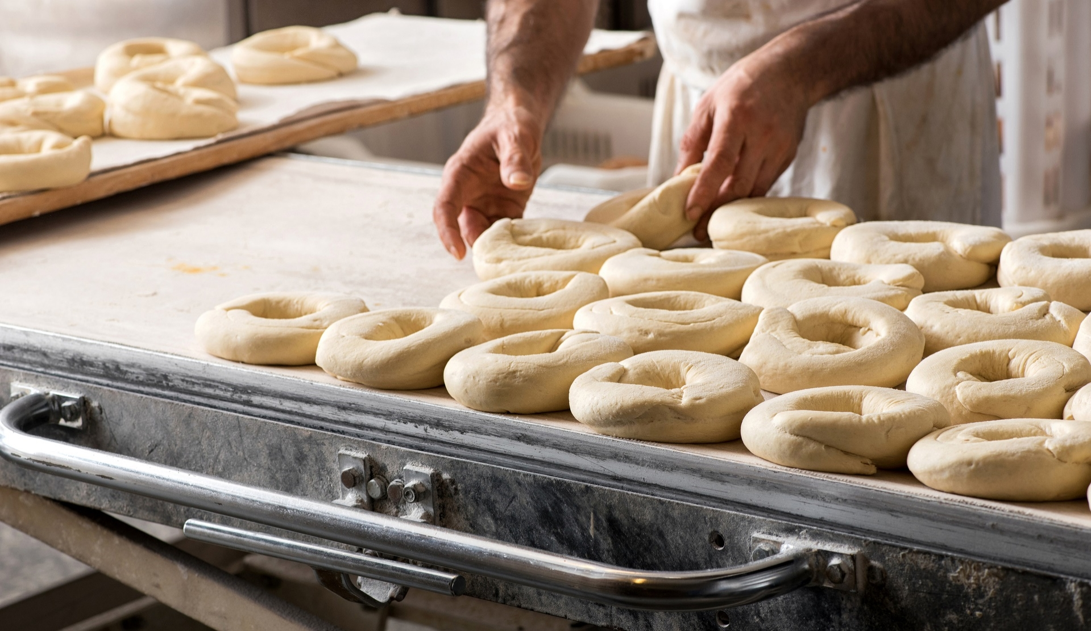
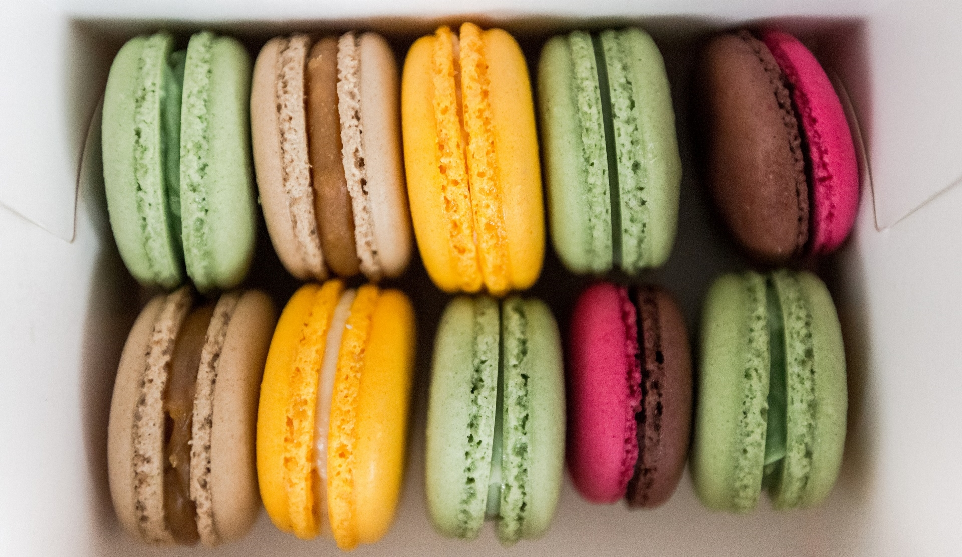
Objective
Introduction
Zomato is one of the leading platforms for discovering restaurants and ordering food. This project analyzes data from Zomato to uncover insights about restaurant trends, customer preferences, and overall business performance.
To explore and analyze the restaurant data using statistical and visual techniques.
To identify factors influencing restaurant rating
To build machine learning models to:
To build machine learning models like Linear Regression, Logistic Regression, and Decision Tree for:
Classifying restaurants as high-rated or low-rated
Predicting restaurant ratings
Predicting restaurants success based on other factors
To support decision-making for both customers and business stakeholders

Slide 4

Data Collection & Understanding

Slide 5
Data Source:
Dataset collected from Kaggle (Zomato EDA)
Cleaned and preprocessed version used for analysis
Number of Records:
Final cleaned dataset contains 30,959 restaurant entries after removing duplicates, missing, and irrelevant data
Data Format: CSV
Focus Area: Karnataka, India
Key Attributes: restaurant, location, rating, votes, cost, cuisines, online order, table booking, types, rest type.

Slide 6
Data Cleaning & Preprocessing

Slide 7
Data Cleaning:
Deleting redundant columns that are not useful for analysis.
Renaming the columns for better readability.
Dropping duplicate restaurant entries.
Cleaning individual columns (e.g., price, rating, cuisines).
Removing NaN (missing values) From the dataset.
Applied necessary transformations to standardize the data.
Raw Data
↓
Remove Duplicates
↓
Handle Missing Values
↓
Rename Columns
↓
Clean Individual Columns
↓
Final Dataset

Slide 8
Exploratory Data Analysis

Slide 9
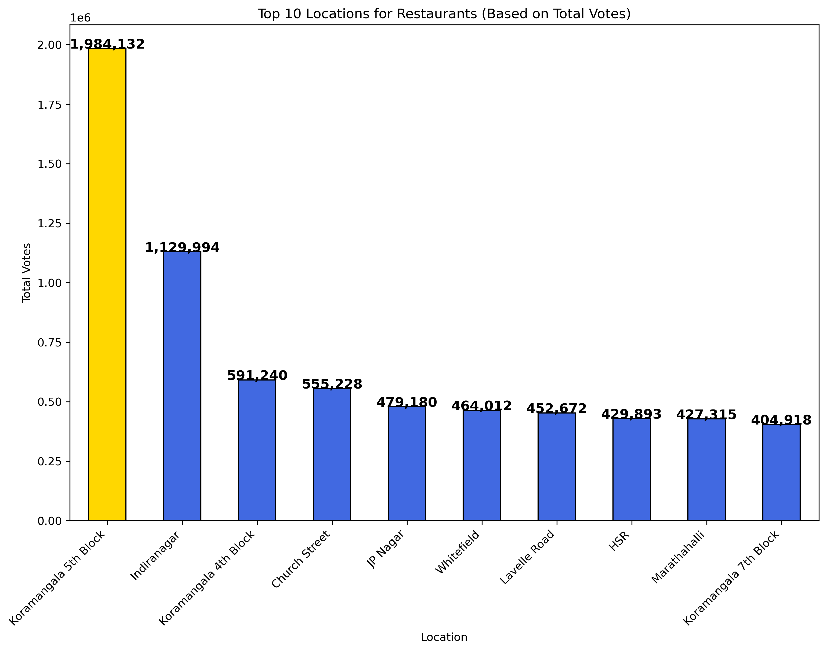
Best Location Based on votes
Key Observations:
Areas like Koramangala 5th Block, 4th Block, Indiranagar, and Church Street got the highest number of votes.
These areas show high customer engagement.
Insights:
Customers are very active in these areas.
Restaurants here are likely to be popular and frequently visited.
Recommendations:
Boost social media presence to get more votes.
Focus on excellent customer service.
Join community programs like donating extra food.
Start loyalty programs to bring back happy customers.

Slide 10
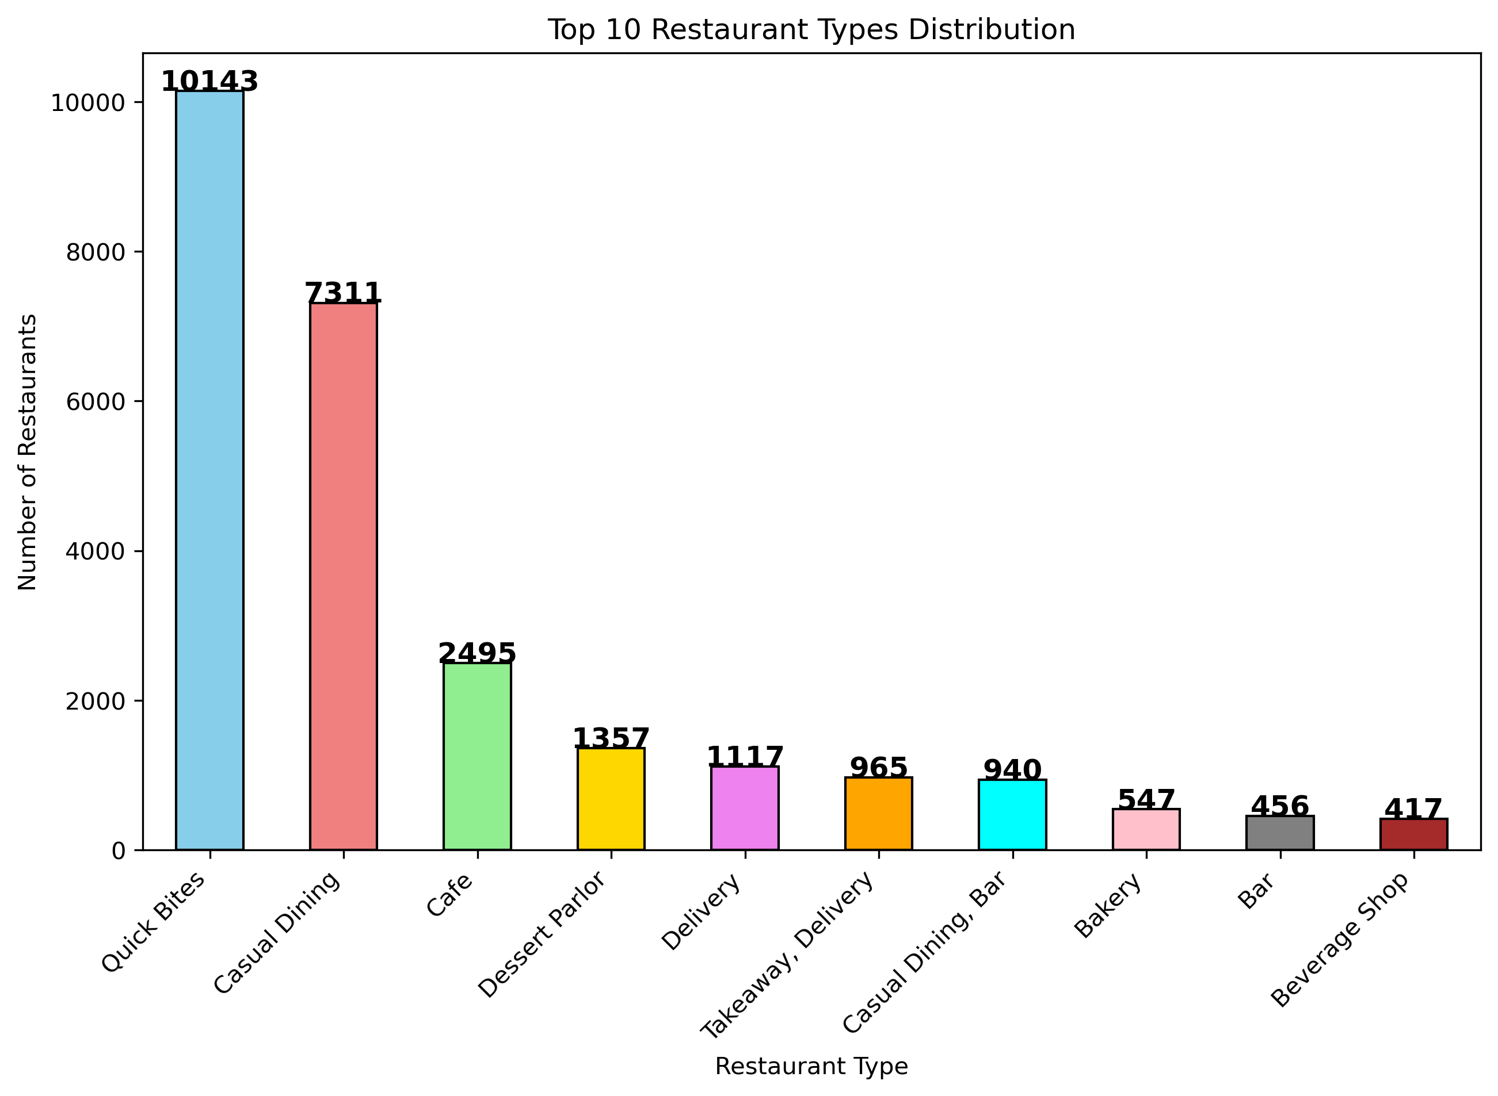
Restaurant type distributions
Key Observations:
Quick Bites and Casual Dining are the most common types.
Beverage Shops have a smaller share in the market.
Insights:
Most restaurants focus on affordable and casual food options.
High-end dining is less common.
Recommendations:
New restaurants can choose Quick Bites or Casual Dining for budget-friendly service.
Fine Dining should target customers who want premium food and experience.

Slide 11
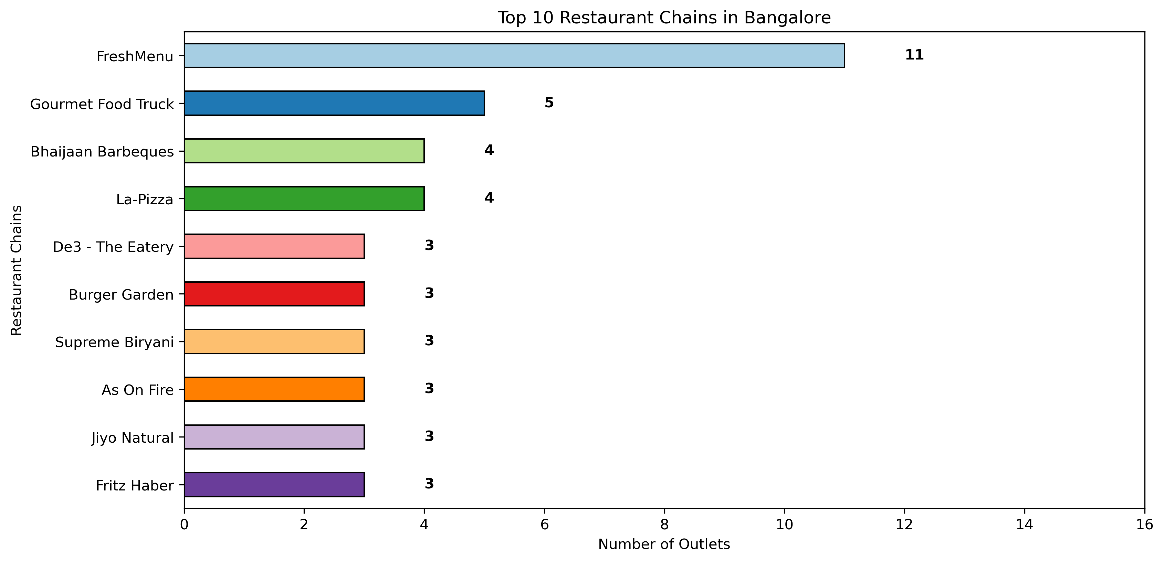
Most Popular Restaurants Chains in Bangalore
Key Observations:
FreshMenu, Gourmet Food Truck, Bhaijaan Barbeques, and La-Pino'z Pizza have the most outlets.
Insights:
Fast food chains are popular because they are affordable and quick.
Recommendations:
New brands should open in high-demand locations.
Local restaurants can join food delivery apps to reach more customers.

Slide 12
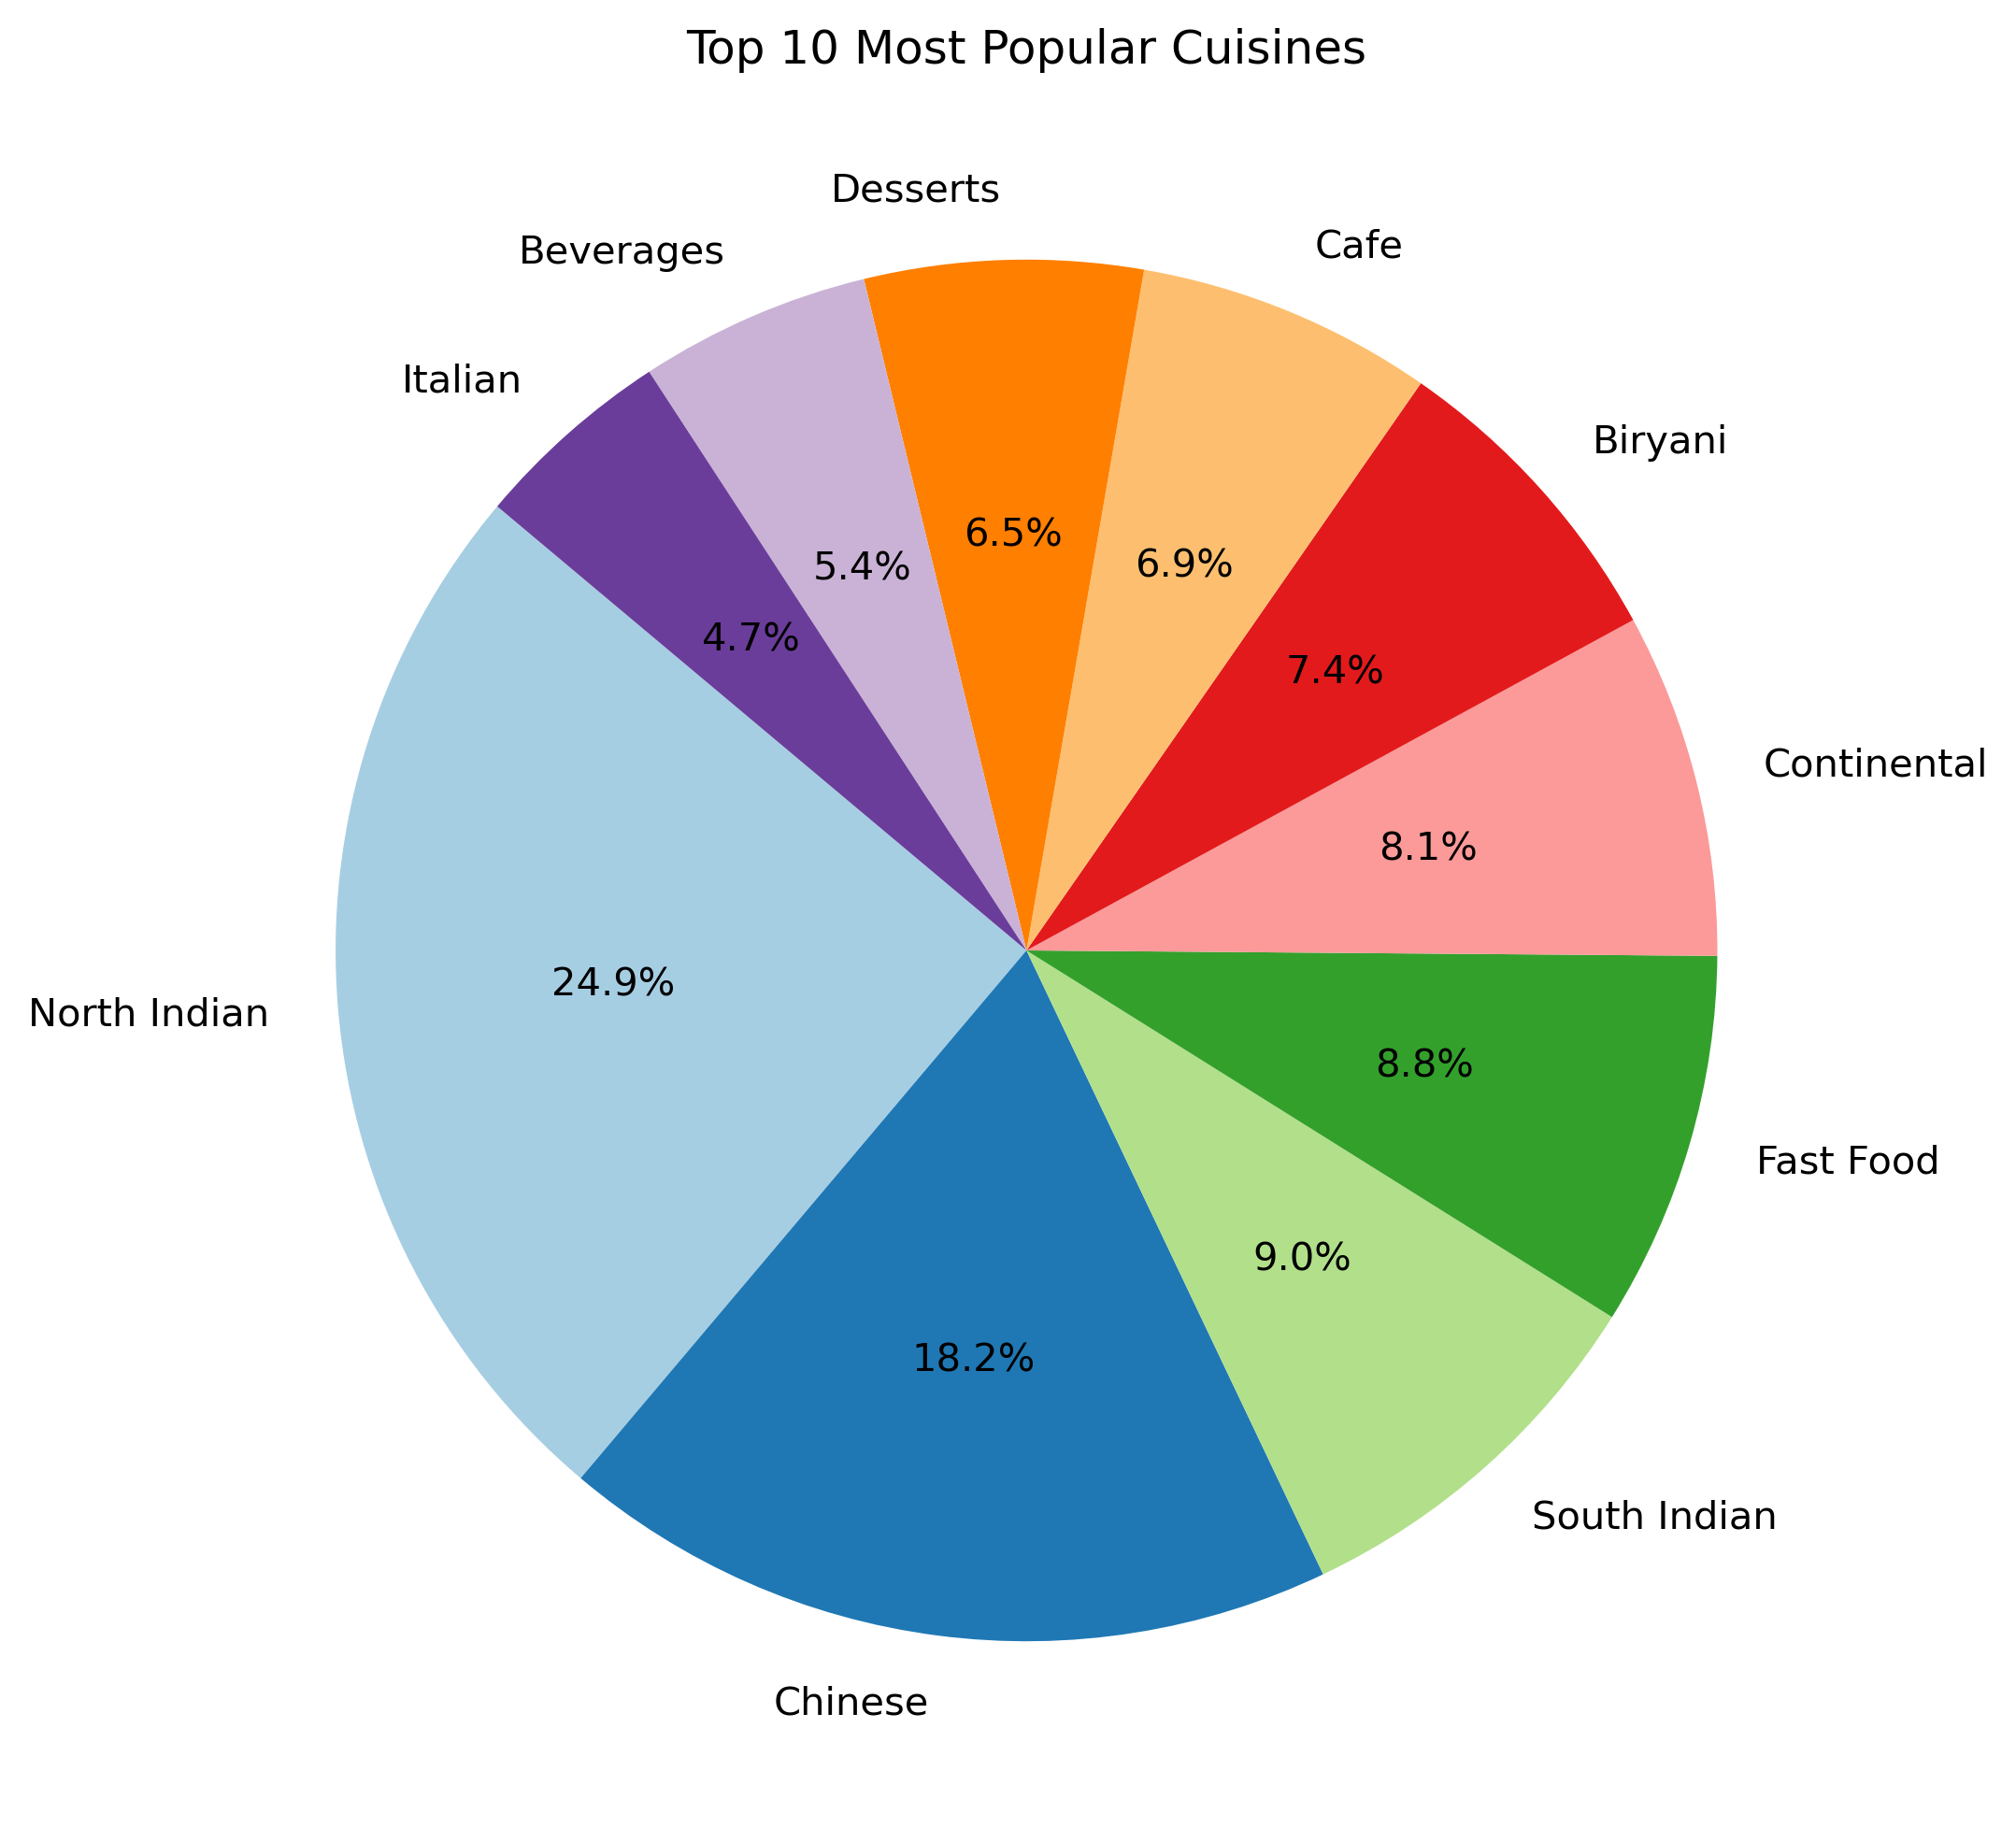
Most Popular Cuisines
Key Observations:
North Indian and Chinese cuisines are the most preferred by customers.
Insights:
People like traditional and Asian food.
Recommendations:
New restaurants should serve the North Indian and Chinese.
Try fusion food to attract more customers with unique flavors.

Slide 13
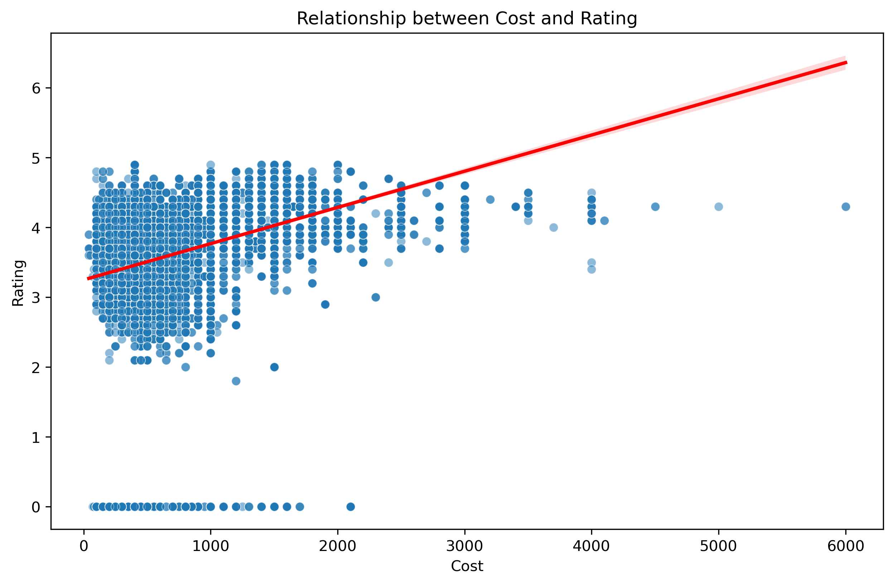
Relationship between cost and rating
Key Findings:
Higher cost = Higher rating — more expensive restaurants usually get better reviews.
Cost goes up to ₹6000 in some places.
Lower-cost restaurants (under ₹2000) have mixed ratings.
High-cost restaurants often offer a premium experience, leading to better ratings.
Conclusion:
Expensive restaurants tend to be rated higher.
But many customers still choose based on affordability.

Slide 14
Statistical Analysis

Slide 15
What is the average cost for dining in Bangalore restaurants? Does the median cost differ significantly from the mean?
Findings:
Mean Cost: ₹625
Median Cost: ₹500
Insight:
The mean cost is higher than the median, which suggests the presence of expensive restaurants pulling the average up.
Conclusion:
Most restaurants are affordable, but a few high-end restaurants significantly increase the overall average.

Slide 16
Which restaurant cost is the most common among customers?
Findings:
Most Frequent Cost: ₹400
This is the most popular price point among restaurants, indicating the affordability and Customer Preference.
Here Some of the Restaurants with ₹400 Cost:
360 Atoms Restaurant And Cafe
The Vintage Cafe
Fast And Fresh
Hotboxit
Corner House Ice Cream
XO Belgian Waffle
Kabab Magic
Frozen Bottle
Polar Bear
Floured – Baked With Love

Slide 17
Does higher cost of dining lead to restaurant ratings?
📊 Test Result
T-Statistics: 47.68
P-Value: 0.0000
✅ Conclusion: There is a significant relationship between dining cost and restaurant rating. As the cost increases, ratings tend to be higher, indicating customers associate higher prices with better quality or experience.
📌 Recommendations:
✅ Offer premium options for high-paying customers.
✅ Enhance ambience, service, and quality to justify higher costs.
✅ Keep affordable items too, to cater to all types of customers.
✅ Showcase value clearly in menus, décor, and customer service.

Slide 18
Which cuisines receive the highest and lowest rating?
📊 Test Result:
T-Statistics: 5.73
P-Value: 0.0000
✅ Conclusion: There is a significant difference in restaurant ratings across cuisines.
🌟 Top Rated Cuisines
Asian, Chinese, Thai, Momos – ⭐️ 4.90 average rating
⚠️ Lowest Rated Cuisines
American, Cafe, Chinese, Italian, Desserts – ⚠️ 0.00 average rating
📌 Recommendations:
🍜 Focus on high-performing cuisines like Asian & Thai.
🍕 Improve quality or presentation in low-rated cuisine categories.
📋 Use customer feedback to enhance low-rated menus.
🔍 Future analysis can include a post-hoc test to identify which specific cuisines differ significantly from others.

Slide 19
Are expensive restaurants more engaging(getting more votes)?
🔍 Test Result:
Correlation Coefficient: 0.38
P-Value: 0.0000
✅ Conclusion:
There is a moderate positive correlation between restaurant cost and customer engagement (votes).
💬 This means: Higher-cost restaurants tend to get more votes, possibly due to better ambiance, food quality, or branding.
📌 Recommendations:
💡 Invest in restaurant ambiance and service quality to increase engagement.
📱 Encourage reviews and votes via digital platforms.
🤝 Promote customer loyalty and referrals to gain consistent engagement.

Slide 20
Business Insights

Slide 21
What are the best locations to open new restaurants(based on average rating)?
📊 Analysis Result (Top 5 Locations by Average Rating):
Lavelle Road — 4.12
St. Marks Road — 4.10
Church Street — 4.04
Koramangala 5th Block — 4.04
Sankey Road — 4.01
💡 Insights:
These locations consistently receive higher customer ratings.
Indicate strong customer satisfaction and positive dining experiences.
Likely to have better footfall and a customer-friendly atmosphere.
📌 Recommendations:
New restaurants can be opened in these areas to capitalize on customer preferences.
Focus on premium service and ambiance to match local standards.
Partner with food delivery services in these locations to increase reach and visibility.

Slide 22
What are the best locations to open new restaurants(based on votes)?
🔍 Key Observations
📍 Koramangala 5th Block has the highest votes (19.8 lakh+).
📍 Indiranagar, Koramangala 4th Block, and Church Street also show high engagement.
📍 These areas are food hubs with lots of customer activity.
💡 Insights
🙋‍♂️ More votes = Higher customer interest and footfall.
🌟 These locations are already popular and trusted by food lovers.
✅ Recommendations
🏪 Open restaurants in Koramangala, Indiranagar, and Church Street.
💬 Use social media to attract and engage customers.
🎁 Introduce loyalty programs and offer unique dishes to stand out.

Slide 23
What are the best locations to open new restaurants(based on location with demand but fewer restaurants)?
🔍 Key Observations
🏙️ Cunningham Road and St. Marks Road have high votes but fewer restaurants.
📉 Koramangala 3rd Block, Domlur, and Jeevan Bhima Nagar also show good demand with limited supply.
💡 Insights
📈 High customer demand is seen in these areas.
🍽️ Fewer existing restaurants = less competition.
⚡ This creates a strong growth opportunity.
Recommendations
📌 Target these areas for new restaurant openings.
🎯 Focus on quick service or unique cuisines to attract early attention.
📣 Use local advertising and food delivery apps to boost visibility.

Slide 24
✅ Conclusion: Best Locations to Open New Restaurants
📊 Based on Three Key Factors:
🏅 Highest Average Ratings
1.Top Areas: Lavelle Road, St. Marks Road, Church Street
2.These areas reflect customer satisfaction and quality dining experiences.
2.🗳️ Most Voted Locations
1.Top Areas: Koramangala 5th Block, Indiranagar, Church Street
2.High customer engagement and popularity.
3.📈 High Demand with Fewer Restaurants
1.Top Areas: Cunningham Road, St. Marks Road, Domlur
2.Low competition with strong demand makes these ideal spots for new ventures.
💡 Final Recommendation: To balance popularity, customer satisfaction, and market opportunity, focus on areas like:
St. Marks Road (appears in all 3 lists)
Church Street
Cunningham Road
These locations offer the best strategic potential for launching successful new restaurants.

Slide 25
Which restaurant chains dominates Bangalore market?
📊 Top Restaurant Chains in Bangalore
🏢 Restaurant Chain | 🏬 Number of Outlets
Cafe Coffee Day | 82
Onesta | 81
Empire Restaurant | 68
Kanti Sweets | 60
Just Bake | 56
Pizza Hut | 55
KFC | 54
Domino’s Pizza | 54
Five Star Chicken | 54
Smally’s Resto Cafe | 53

Slide 26
📈 Top 10 Restaurant Chains by Total Votes
🏢 Restaurant Chain | 👍 Total Votes
Onesta | 335,376
Truffles | 298,697
Empire Restaurant | 221,708
Hammered | 180,602
The Black Pearl | 172,122
Meghana Foods | 122,979
Barbeque Nation | 102,423
Smally’s Resto Cafe | 101,025
Byg Brewski Brewing Company | 99,531
Arbor Brewing Company | 92,362

Slide 27
🔍 Key Observations
☕ Cafe Coffee Day has the highest number of outlets.
🍕 Onesta ranks high in both outlets and votes, showing strong presence and popularity.
🏆 Chains like Truffles and Empire Restaurant have high customer engagement despite fewer outlets.
💡 Insights
Fast food and casual dining chains dominate the Bangalore market.
Customer preference aligns with affordability and wide presence.
📌 Recommendations
Emerging brands should analyze high-performing chains like Onesta and Truffles for growth strategies.
Partnering with delivery platforms and maintaining quality across outlets can help increase both reach and reputation.

Slide 28
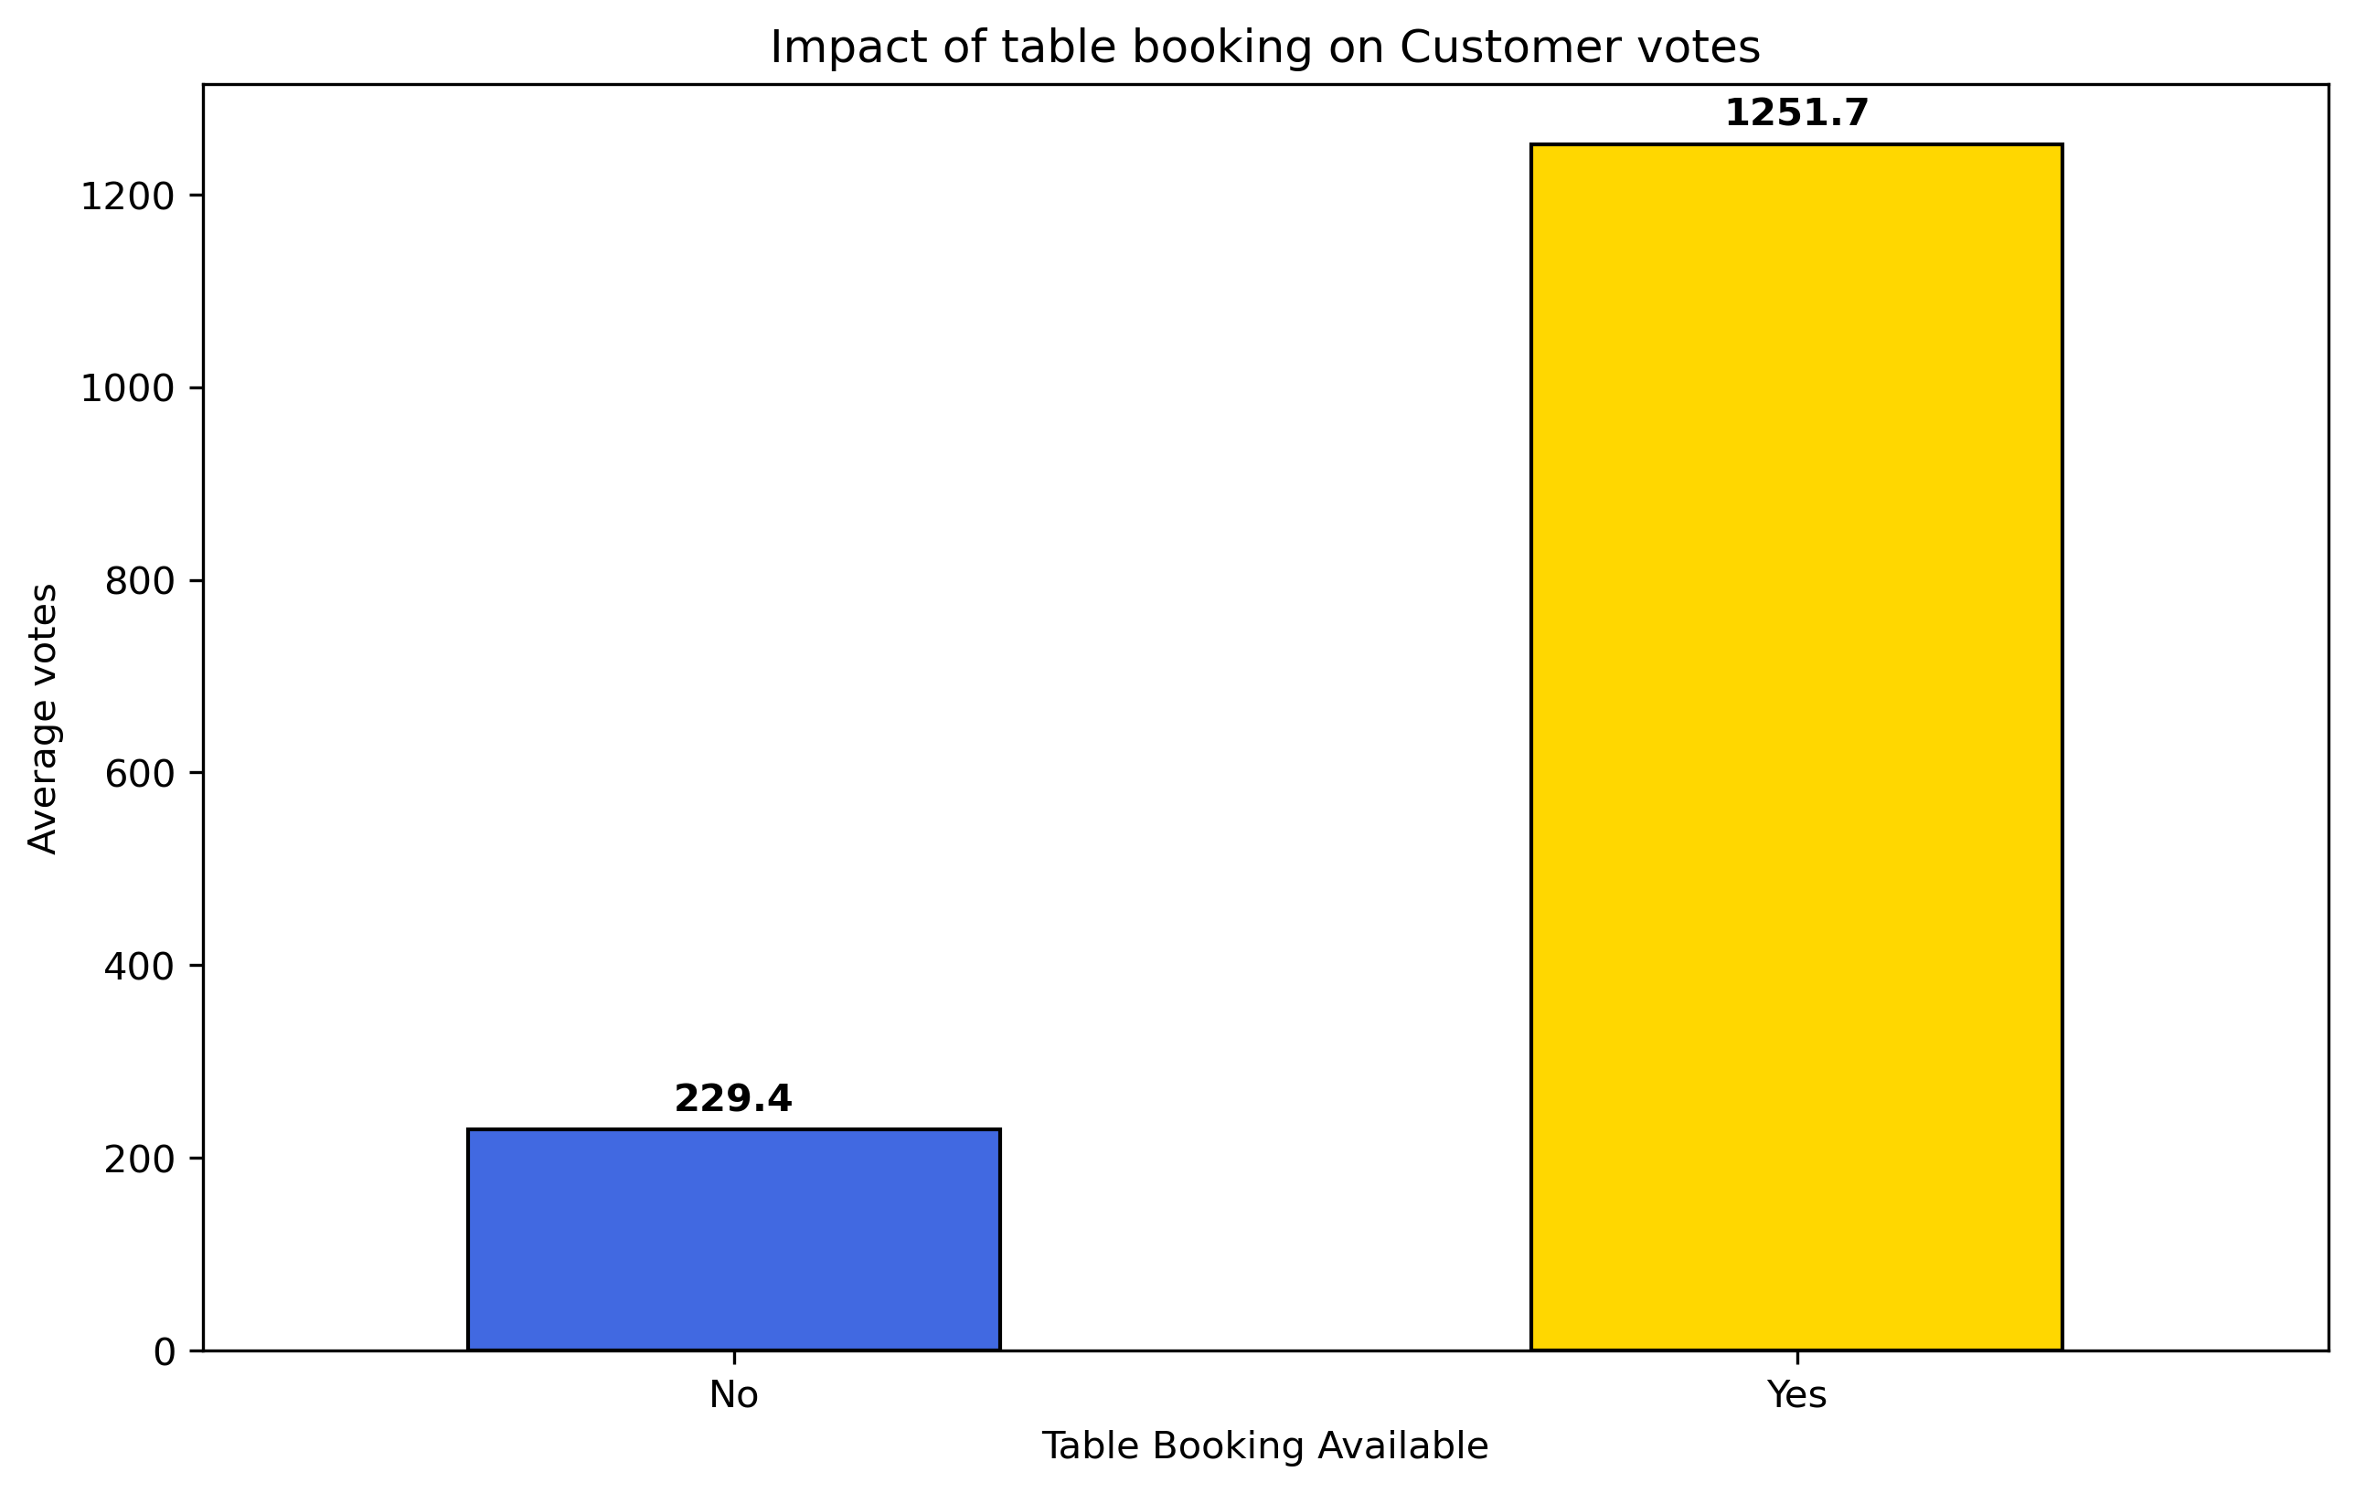
Do restaurants that offers table booking attract more customers?
🔍 Key Observations:
Restaurants that offer table booking have an average of 1251.7 votes.
Restaurants that do not offer table booking have only 229.4 votes.
💡 Insight:
Offering table booking seems to attract more customers and engagement.
📌 Recommendations:
Restaurants should enable table booking options to increase customer traffic.
Consider promoting table booking services through online platforms and restaurant apps.

Slide 29
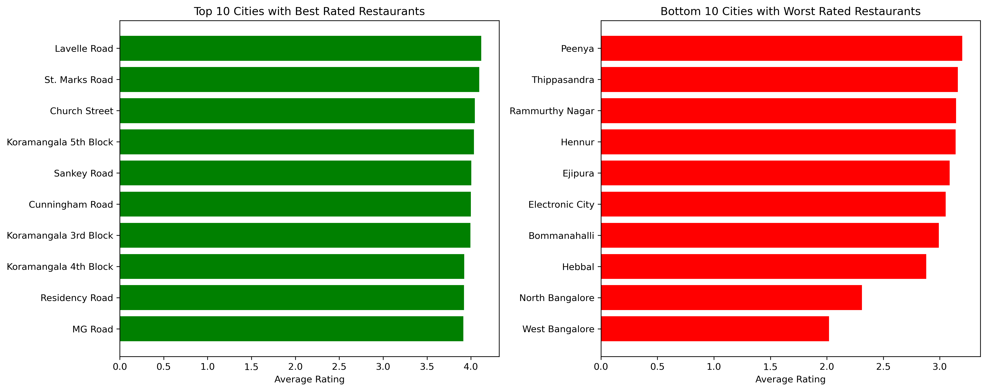
Which cities have best and worst rated restaurants?
🔍 Key Observations:
Top 10 Locations (Highest Ratings): 📍 Lavelle Road, 📍 St. Marks Road, 📍 Church Street, 📍 Koramangala 5th Block, 📍 Sankey Road, 📍 Cunningham Road, 📍 Koramangala 3rd Block, 📍 Koramangala 4th Block, 📍 Residency Road, 📍 MG Road
Bottom 10 Locations (Lowest Ratings): 📍 Peenya, 📍 Thippasandra, 📍 Rammurthy Nagar, 📍 Hennur, 📍 Ejipura, 📍 Electronic City, 📍 Bommanahalli, 📍 Hebbal, 📍 North Bangalore, 📍 West Bangalore
💡 Insights:
High-rated areas likely offer better food, service & ambiance.
Low-rated areas may suffer from poor food quality or service issues.
Recommendations:
✅ For High-Rated Areas:
Maintain quality and service.
Promote customer reviews and loyalty.
⚠ For Low-Rated Areas:
Improve food & service standards.
Offer promotions & loyalty programs.
Use TV, pamphlets & digital ads for visibility.
Hire skilled chefs (no formal degree required).
Add seasonal/festival decor.
Host events with influencers or celebrities.

Slide 30
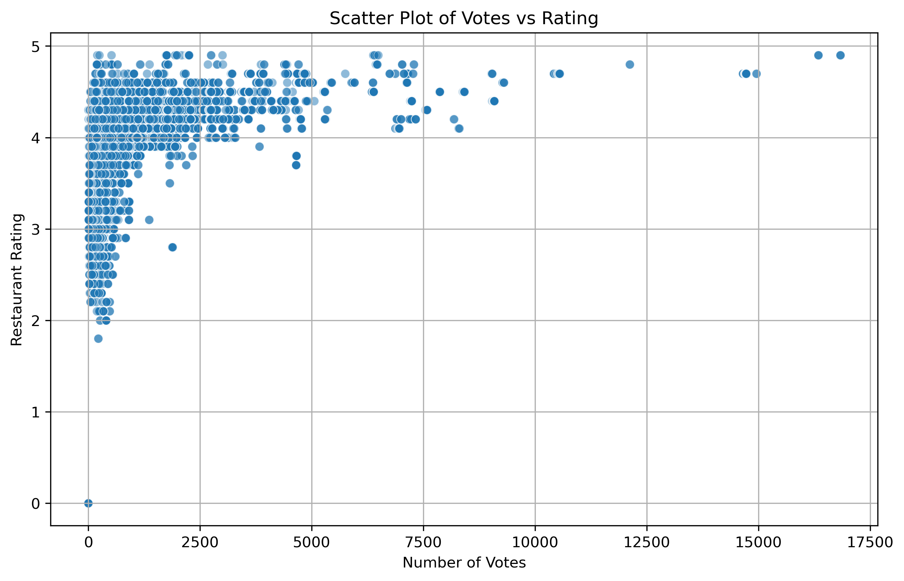
Do higher votes indicate a more popular and highly rated restaurant?
🔍 Key Observations:
📈 More votes → Better ratings: Popular restaurants often get higher ratings.
🎯 Low votes, mixed ratings: Some lesser-known restaurants still offer great quality.
🛑 Stabilizing point: After ~4.0–4.5 rating, more votes don't increase ratings much.
💡 Insight:
Higher votes usually mean higher ratings — but not always.
Some low-vote restaurants are excellent, others are not.
Reputation = Quality + Engagement, not just vote count.
📌 Recommendations:
✅ Allow table booking to attract more customers. ✅ Promote booking features online and offline. ✅ Encourage customer reviews for better visibility. ✅ Focus on consistent food & service quality to maintain high ratings.

Slide 31
Dashboard

Slide 32
Dashboard Insights Summary
📌 Introduction: This dashboard analyzes restaurant ratings, costs, locations, and customer preferences.
🍽️ Top 10 Highest Rated Restaurants: Brahmin’s Coffee Bar, Byg Brewski, AB’s Barbecues, Belgian Waffle, Punjab Grill, Mainland China, Flechazo, Milano Ice Cream, Santspa Cuisine.
📍 Top Locations Based on Rating: Sarjapur Road, Marathahalli, Indiranagar, Koramangala 5th Block, Old Airport Road.
🏪 Famous Restaurant Chains in Bangalore: FreshMenu, Night Bell, Desi Chinese, La-Pizza, S.W.A.T Truck, Hyderabad Biryani Home, Belly Squad, As on Fire, Amexicano, Fit Dish Fetish.
📦 Online Ordering vs Ratings: Restaurants with online ordering have slightly higher ratings (3.63) than those without (3.43).
🍽️ Table Booking Impact: Restaurants offering table booking have higher ratings (4.10) vs. those without (3.40).
🏷️ Most Popular Restaurant Types (by votes):
Café & Casual Dining
Casual Dining
Casual Dining & Bar
Microbrewery
Pub & Microbrewery
🍴 Cuisines with 4.5+ Ratings: Cafe, American, North Indian, European, Mediterranean, Italian, Pizza, BBQ, Finger Food.
💰 Average Cost by Cuisine:
Most Expensive: French, Italian (₹6000)
Most Affordable: Italian, North Indian, South Indian, Japanese (₹4000)
📍 Cost by Location:
Highest: Sankey Road (₹9100)
Lowest: Old Airport Road, Domlur, Indiranagar (₹40)

Slide 33
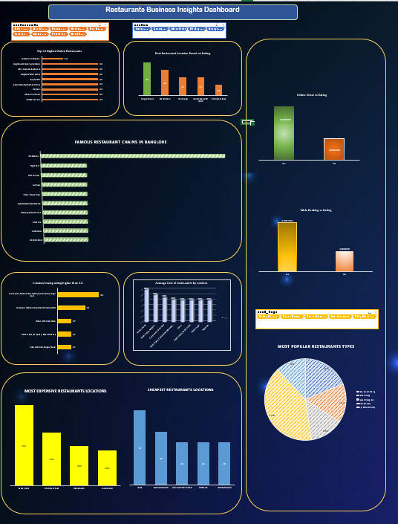
Preview Of Dashboard

Slide 34
Linear Regression Model

Slide 35
Predict Restaurants Success based on cost, votes, location, and cuisines?
✅ Model Performance
Metric | Value
MAE | 0.4628
MSE | 0.6480
RMSE | 0.8050
R² Score | 0.1603
📌 Insights
The model’s predictions are on average ±0.46 stars off.
Explains 16% of the variation in ratings.
Features like votes, cost, and service options influence ratings, but other factors likely play a bigger role.
📌 Next Steps
Add more features (like cuisine, review sentiment, location).
Try other models like Random Forest, XGBoost, etc.

Slide 36
Logistic Regression Model

Slide 37
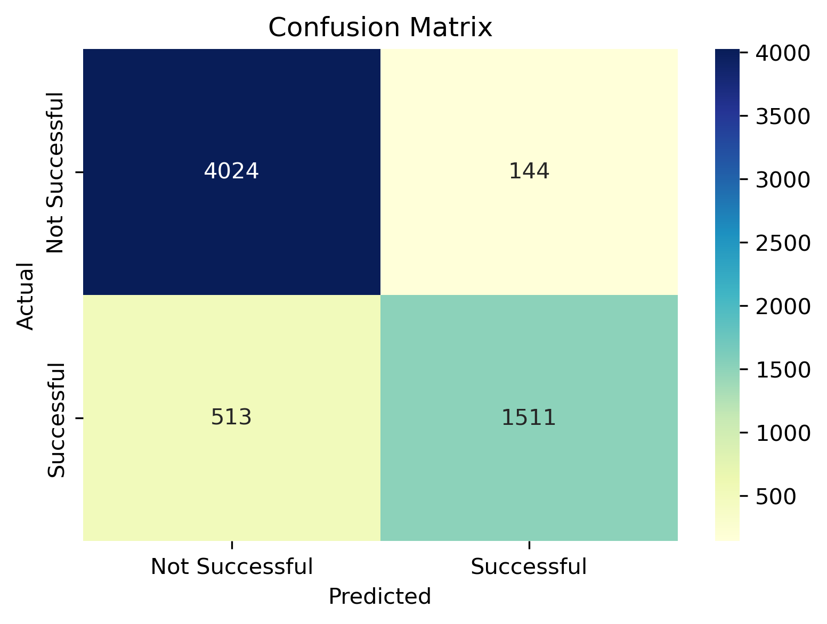
Predict Restaurants Success based on cost, votes, location, and cuisines?
🎯 Goal
Classify whether a restaurant is Successful based on:
Cost
Votes
Location
Cuisines
🧠 Model Used
Logistic Regression
Best for predicting binary outcomes (Success / Not Success)

Slide 38
📊 Model Results
Metric | Value
Accuracy | 89.38%
🧾 Confusion Matrix
 | Predicted No | Predicted Yes
Actual No | 4024 (TN) | 144 (FP)
Actual Yes | 513 (FN) | 1511 (TP)
📌 Insights
✅ High accuracy in identifying not successful restaurants.
⚠️ Some successful restaurants were missed (false negatives).
Overall, a strong classification model.
🧭 Next Steps
Try models like Random Forest or XGBoost
Use Cross-validation for reliability
Explore feature importance to understand key drivers

Slide 39
Decision Tree Classifier Model

Slide 40
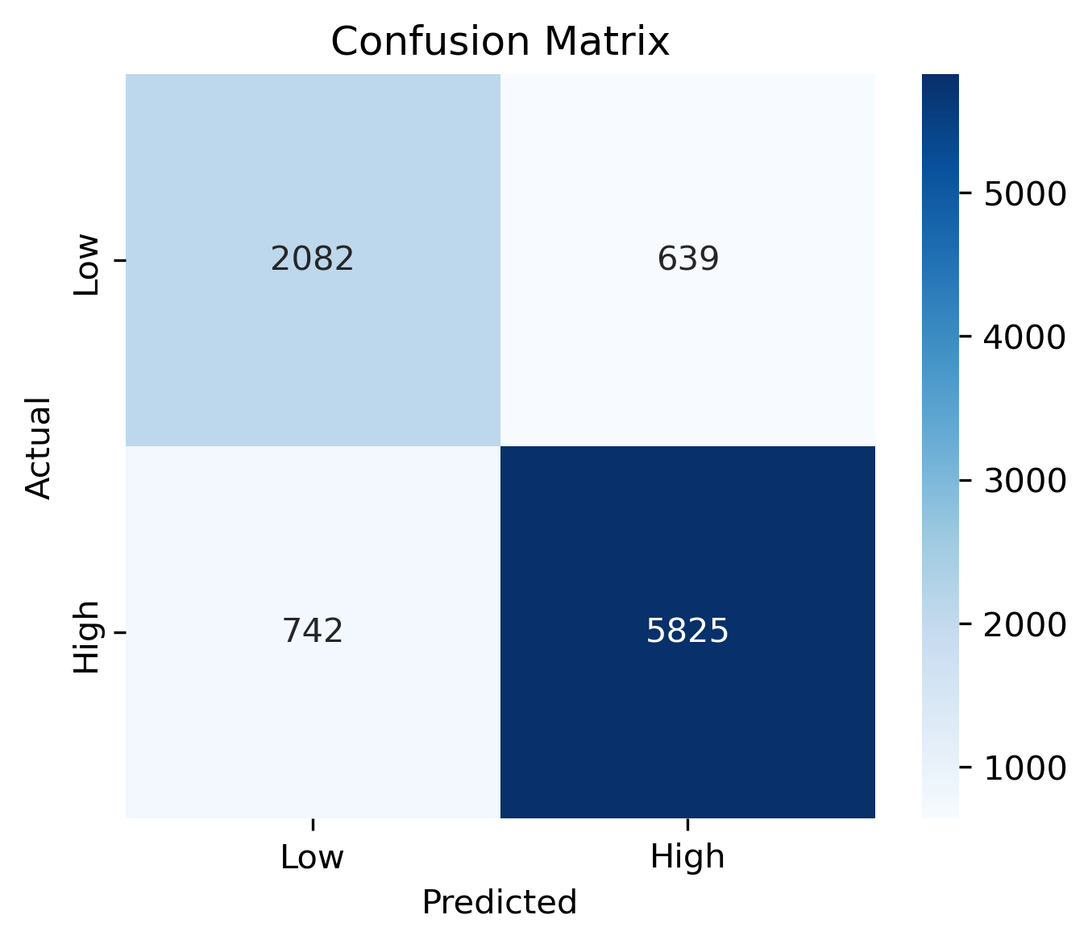
Classify restaurants into high-rated (≥ 3.5) and low-rated (< 3.5) categories using a Decision Tree model based on votes, cost, online order, and table booking.
🎯 Objective
Classify restaurants as:
High-rated (rating ≥ 3.5)
Low-rated (rating < 3.5)
🧪 Model Accuracy
✅ Accuracy: 85.13%
📊 Confusion Matrix
 | Predicted Low | Predicted High
Actual Low (0) | 2082 (✔️) | 639 (❌)
Actual High (1) | 742 (❌) | 5825 (✔️)

Slide 41
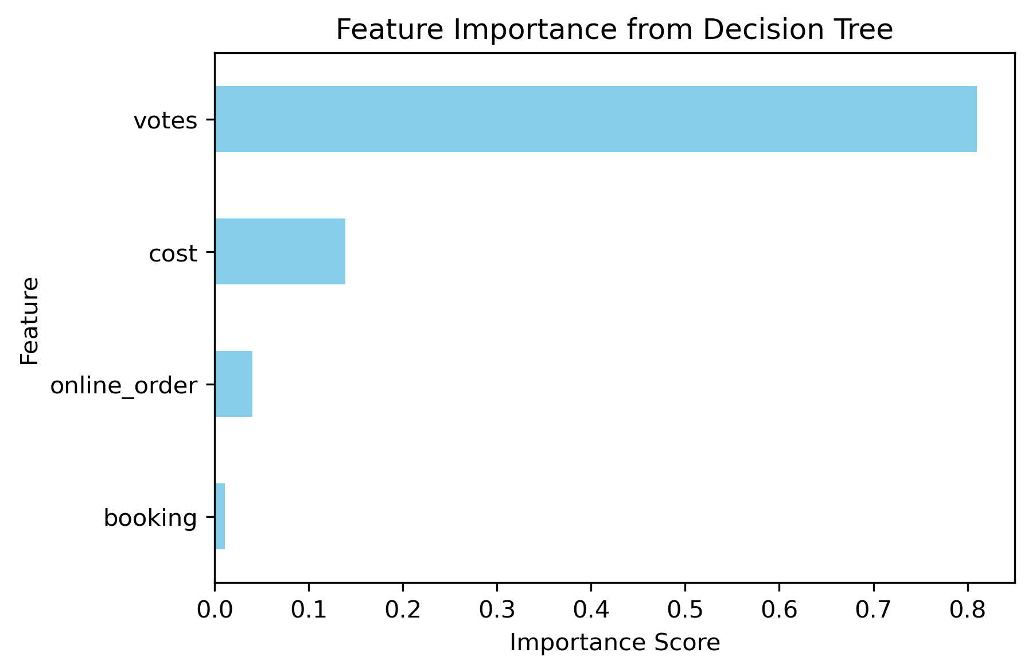
📈 Performance Metrics
Class | Precision | Recall | F1-Score
Low Rating | 0.74 | 0.77 | 0.75
High Rating | 0.90 | 0.89 | 0.89
📌 Insights
✔️ Most high-rated restaurants are correctly predicted.
⚠️ Some low-rated restaurants are misclassified as high-rated.
👌 Overall, model performs well, especially for high ratings.
✅ Conclusion
Great at identifying high-rated restaurants
Slight improvement needed for low-rated prediction
Reliable performance with 85% accuracy

Slide 42



Summary
🎯 Objective: To analyze restaurant data from Zomato in Karanataka and predict ratings/success using machine learning models.
🧹 Data Cleaning:
Removed duplicates and null values
Renaming columns
Removing unwanted columns
Cleaning individual columns
📊 Exploratory Data Analysis (EDA):
Analyzed rating distribution, votes, cost, and cuisine trends.
Identified top locations and famous chains using bar and pie charts.

Slide 43
Summary
📍 Statistical Analysis:
Calculated average, maximum, and minimum costs
Cuisines receives highest and lowest ratings
Done hypothetical testing
📌 Business Insight Questions:
Best and worst rated restaurants
Most common cuisines in Bangalore
Do online orders or table bookings influence ratings?
Where are expensive vs. affordable places?
📉 Visualizations Created:
Scatter plots, bar plots, pie charts
Comparative plots for online order & booking vs. rating
Correlation heatmap to show feature dependencies

Slide 44
Summary
📈 Dashboard:
Created in Excel using pivot charts and slicers
Summary sheet for insights and comparisons
Visual drill-down by area, cuisine, and rating group
📋 Features Used in ML:
Cost, votes, cuisines, location, online_order, booking
🤖 Linear Regression Model:
R^2=0.16,MAE=0.46
Ratings slightly influenced by cost and votes
🔐 Logistic Regression Model:
Accuracy: 89.38%
Predicts whether a restaurant is successful (rating ≥ 4)
Strong at identifying "not successful" restaurants

Slide 45
Summary
🌳 Decision Tree Classifier:
Accuracy: 85.13%
Classifies restaurants into high and low rated (cutoff 3.5)
Very effective for high-rated predictions
📌 ML Conclusion:
Classification models performed better than regression
Votes, cost, and service availability impact predictions
Room for improvement by adding sentiment or review text
🔄 Model Evaluation:
Used MAE, RMSE, R² for regression
Accuracy, confusion matrix, and precision/recall for classification

Slide 46
Summary
🧠 Business Value:
Helps customers identify top places by taste & cost
Assists restaurant owners in understanding key factors affecting success
15.📦 Final Outcome:
Completed full cycle from data cleaning → EDA → dashboard → statistical analysis → ML modeling
Gained actionable insights and built prediction models with real-world use cases

Slide 47

Team
👤 Name: Daroor Pavan Kalyan 📍 Role: Data Analyst 📅 Date:08 April 2025

Slide 48
The way to get started is to quit talking and begin doing.
Walt Disney

Slide 49
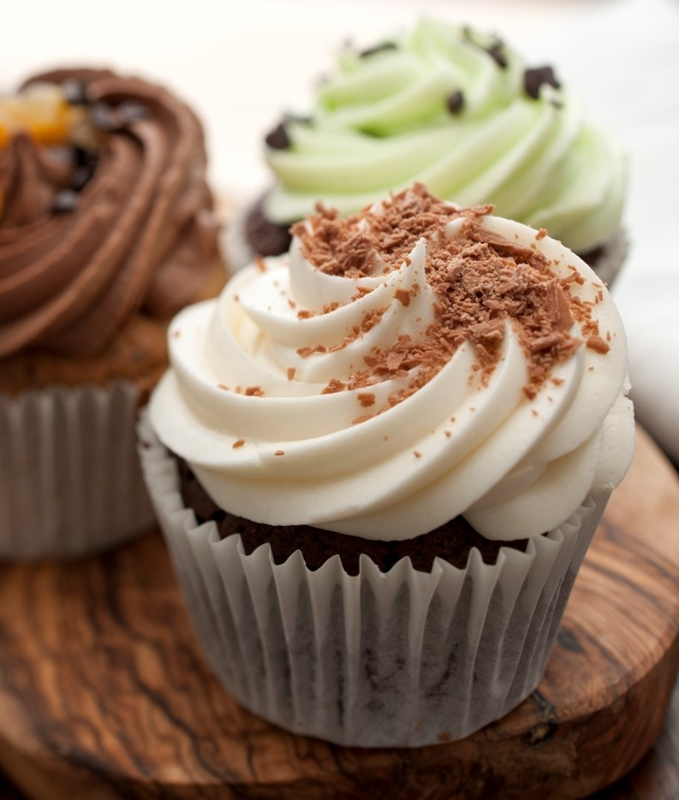
THANK YOU
Daroor Pavan Kalyan
daroorpavankalyan@gmail.com

